Slide 1
Data Mining

Slide 2
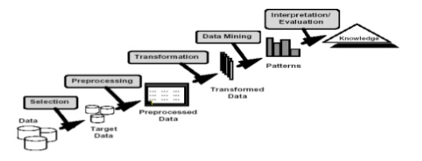
Data Mining
The task of discovering interesting patterns from large amount of data
Knowledge discovery
Is an iterative process

Slide 3
Data
Transactions: online & in-store
Age group: 18-34,34-50,50-68, 68+
Regions: 1-East, 2-West, 3-South, 4-Central
80K instances of data reviewed
Observations
Maximum transactions (26,000) done in Central Region
Age group: 35-50 makes most purchases
East coast customers purchase in-store
West coast customers purchase online
Older customer (68+) purchase online

Slide 4
Recommendations
Attract East Coast customers online
Open more stores on West Coast

Slide 5
Product Wise Market Share

